Slide 1




My Algebra Interactive Notebook
$$3ab$$
$$2x+3y$$
$$\frac{5xy}{6}$$
Name :
Class :
Term 2 Semester 1
$$y=2x+1$$

Slide 2
Contents
Glossary
Page
Date
Description
2
3

Slide 3
Tasks
24
7
30
Essential Question
Questions
Notes
Summary
4
7

Slide 4
24
7
30
Date
Expanding Binomial Expressions
EQ – How do I expand two brackets?
How do I use the table method?

Slide 5
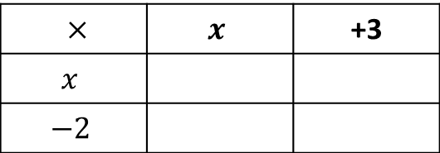

24
7
30
Date
Expanding Binomial Expressions
EQ – How do I expand two brackets?
How do I use the table method?
Expand $(x+3)(x−2)$
$×$ | $$x$$ | +3
$$x$$
$$−2$$

Slide 6
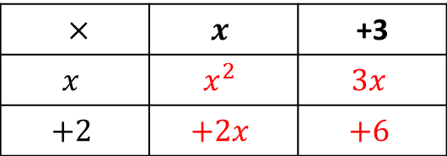

24
7
30
Date
Expanding Binomial Expressions
EQ – How do I expand two brackets?
How do I use the table method?
Expand $(x+3)(x+2)$
$×$ | $$x$$ | +3
$$x$$ | $$x^{2}$$ | $$3x$$
$$+2$$ | $$+2x$$ | $$+6$$

Slide 7
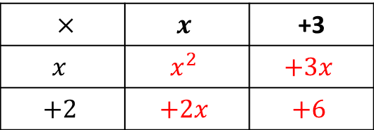

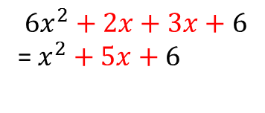
24
7
30
Date
Expanding Binomial Expressions
EQ – How do I expand two brackets?
How do I use the table method?
Expand $\left(x+3\right)\left(x+2\right)=$
$×$ | $$x$$ | +3
$$x$$ | $$x^{2}$$ | $$+3x$$
$$+2$$ | $$+2x$$ | $$+6$$
$$6x^{2}+2x+3x+6$$
=$x^{2}+5x+6$

Slide 8

24
7
30
Date
Expanding Binomial Expressions
EQ – How do I expand two brackets?
How do I use the table method?
Expand $(2x+3)(3x−2)$

Slide 9
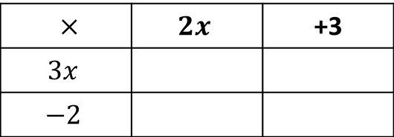
24
7
30
Date
Expanding Binomial Expressions
EQ – How do I expand two brackets?
How do I use the table method?
Expand $(2x+3)(3x−2)$
$×$ | $$2x$$ | +3
$$3x$$
$$−2$$

Slide 10
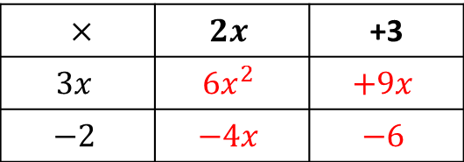
24
7
30
Date
Expanding Binomial Expressions
EQ – How do I expand two brackets?
How do I use the table method?
Expand $(2x+3)(3x−2)$
$×$ | $$2x$$ | +3
$$3x$$ | $$6x^{2}$$ | $$+9x$$
$$−2$$ | $$−4x$$ | $$−6$$

Slide 11
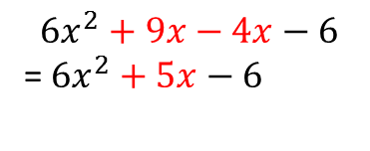
24
7
30
Date
Expanding Binomial Expressions
EQ – How do I expand two brackets?
How do I use the table method?
Expand $(2x+3)(3x−2)$
$×$ | $$2x$$ | +3
$$3x$$ | $$6x^{2}$$ | $$+9x$$
$$−2$$ | $$−4x$$ | $$−6$$
$$6x^{2}+9x−4x−6$$
=$6x^{2}+5x−6$

Slide 12
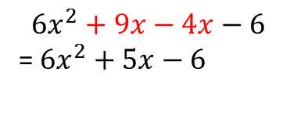
24
7
30
Date
Expanding Binomial Expressions
EQ – How do I expand two brackets?
How do I use the table method?
Expand $(2x+3)(3x−2)$
$×$ | $$2x$$ | +3
$$3x$$ | $$6x^{2}$$ | $$+9x$$
$$−2$$ | $$−4x$$ | $$−6$$
$$6x^{2}+9x−4x−6$$
=$6x^{2}+5x−6$

Slide 13
24
7
30
Date
Expanding Binomial Expressions
EQ – How do I expand two brackets?
How do I use the table method?
Expand $(2x+3)(3x−2)$
$×$ | $$2x$$ | +3
$$3x$$ | $$6x^{2}$$ | $$+9x$$
$$−2$$ | $$−4x$$ | $$−6$$
$$6x^{2}+9x−4x−6$$
=$6x^{2}+5x−6$
How do I use the FOIL method?

Slide 14
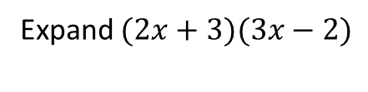
24
7
30
Date
Expanding Binomial Expressions
EQ – How do I expand two brackets?
How do I use the table method?
Expand $(2x+3)(3x−2)$
$×$ | $$2x$$ | +3
$$3x$$ | $$6x^{2}$$ | $$+9x$$
$$−2$$ | $$−4x$$ | $$−6$$
$$6x^{2}+9x−4x−6$$
=$6x^{2}+5x−6$
How do I use the FOIL method?
First
Outside
Inner
Last
Expand $(2x+3)(3x−2)$

Slide 15
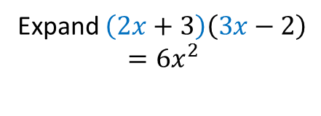
24
7
30
Date
Expanding Binomial Expressions
EQ – How do I expand two brackets?
How do I use the table method?
Expand $(2x+3)(3x−2)$
$×$ | $$2x$$ | +3
$$3x$$ | $$6x^{2}$$ | $$+9x$$
$$−2$$ | $$−4x$$ | $$−6$$
$$6x^{2}+9x−4x−6$$
=$6x^{2}+5x−6$
How do I use the FOIL method?
First
Outside
Inner
Last
Expand $\left(2x+3\right)\left(3x−2\right)$
$$=6x^{2}$$

Slide 16
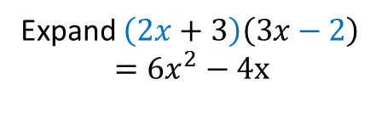
24
7
30
Date
Expanding Binomial Expressions
EQ – How do I expand two brackets?
How do I use the table method?
Expand $(2x+3)(3x−2)$
$×$ | $$2x$$ | +3
$$3x$$ | $$6x^{2}$$ | $$+9x$$
$$−2$$ | $$−4x$$ | $$−6$$
$$6x^{2}+9x−4x−6$$
=$6x^{2}+5x−6$
How do I use the FOIL method?
First
Outside
Inner
Last
Expand $\left(2x+3\right)\left(3x−2\right)$
$$=6x^{2}−4x$$

Slide 17
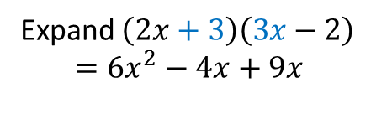
24
7
30
Date
Expanding Binomial Expressions
EQ – How do I expand two brackets?
How do I use the table method?
Expand $(2x+3)(3x−2)$
$×$ | $$2x$$ | +3
$$3x$$ | $$6x^{2}$$ | $$+9x$$
$$−2$$ | $$−4x$$ | $$−6$$
$$6x^{2}+9x−4x−6$$
=$6x^{2}+5x−6$
How do I use the FOIL method?
First
Outside
Inner
Last
Expand $\left(2x+3\right)\left(3x−2\right)$
$$=6x^{2}−4x+9x$$

Slide 18
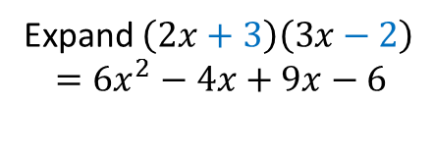
24
7
30
Date
Expanding Binomial Expressions
EQ – How do I expand two brackets?
How do I use the table method?
Expand $(2x+3)(3x−2)$
$×$ | $$2x$$ | +3
$$3x$$ | $$6x^{2}$$ | $$+9x$$
$$−2$$ | $$−4x$$ | $$−6$$
$$6x^{2}+9x−4x−6$$
=$6x^{2}+5x−6$
How do I use the FOIL method?
First
Outside
Inner
Last
Expand $\left(2x+3\right)\left(3x−2\right)$
$$=6x^{2}−4x+9x−6$$

Slide 19
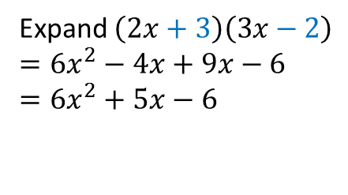
24
7
30
Date
Expanding Binomial Expressions
EQ – How do I expand two brackets?
How do I use the table method?
Expand $(2x+3)(3x−2)$
$×$ | $$2x$$ | +3
$$3x$$ | $$6x^{2}$$ | $$+9x$$
$$−2$$ | $$−4x$$ | $$−6$$
$$6x^{2}+9x−4x−6$$
=$6x^{2}+5x−6$
How do I use the FOIL method?
First
Outside
Inner
Last
Expand $\left(2x+3\right)\left(3x−2\right)$
$$=6x^{2}−4x+9x−6$$
$$=6x^{2}+5x−6$$

Slide 21
Homework
Review your notes and write a summary answering the essential question.

